Slide 1



Net Medical Xpress Labs
BioFire Joint Infection Panel
Synovial Fluid Collection/Transport

Slide 2
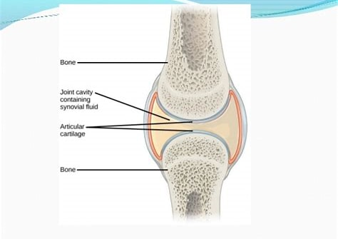
Synovial Fluid
Synovial fluid is normally a thick, straw-colored liquid found in small amounts in joints. After the skin around the joint is cleaned, the health care provider inserts a sterile needle through the skin and into the joint space. Fluid is then drawn through the needle into a sterile syringe. The fluid sample is sent to our lab for testing.

Slide 3
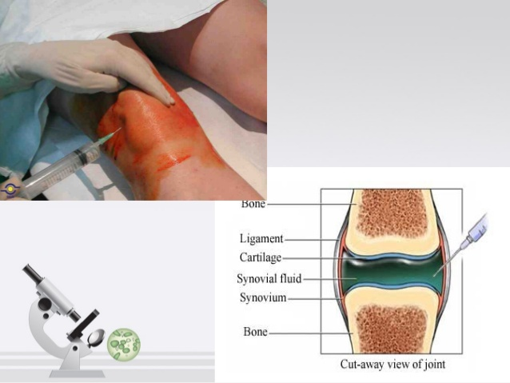
Net Medical Xpress Labs

Slide 4
Volume = 3-5 mL sterile tube biohazard bag absorbent material stored/shipped @ 2*-8*C icepack is not to touch sample shipped for overnight delivery name/dob of patient date & time of collection face sheet of patient
Specimen Requirements:

Slide 5
How to Ship Safely
UPS PACKAGING LABELING
EXEMPT HUMAN SPECIMEN
ALWAYS…TRIPLE PACKAGING!!
SHIPPER’S NAME & ADDRESS & CONTACT #
RECEIVER’S NAME & ADDRESS & CONTACT #
EXEMPT HUMAN SPECIMEN
LABELS(NONE REQUIRED)

Slide 6
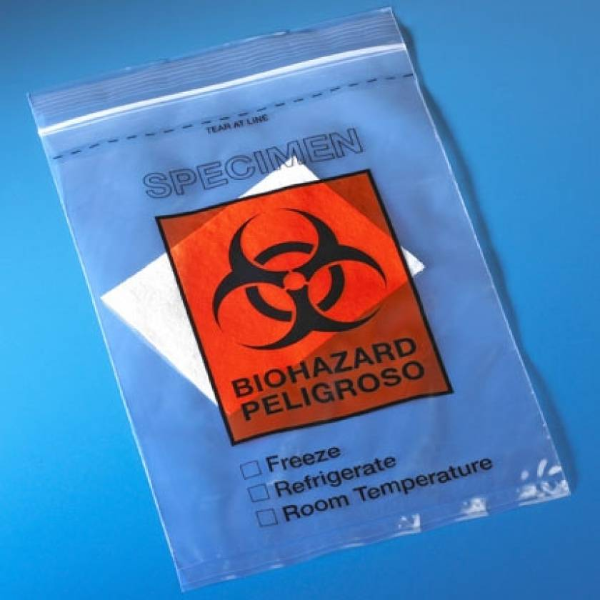
BIOHAZARD BAG
Net Medical Labs will provide:

Slide 7
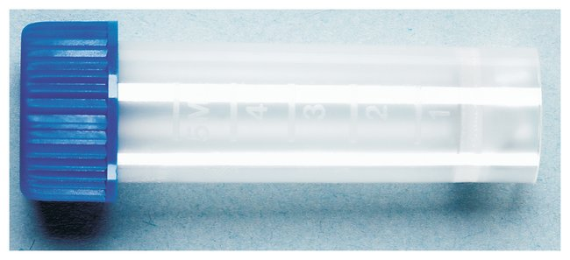
STERILE VIAL

Slide 8
NET MEDICAL XPRESS LABS – Company Information
Address: 8206 Louisiana Blvd. NE, Suite A, Albuquerque, NM 87113
Phone: 505-255-1999 ext. 300
Fax: 505-255-7201
Website: https://welcome.netmedical.com
Attn: Gary Ayres, Lab Director
SHIPPING ADDRESS

